Slide 1
Echocardiographic assesment of shunt lesion
Dr. Sreejith V

Slide 2
INDIRECT EVIDENCES

Slide 3
2D imaging
ASD
Dilation RA and RV
Paradoxical septal motion
PDA & VSD
Dilation LA and LV.
Both
Size of the defect

Slide 4
PW Doppler or CDE
Flow disturbance is found downstream from the defect.
PDA
Colour Doppler ductal diameter
Diastolic flow reversal in descending aorta

Slide 5
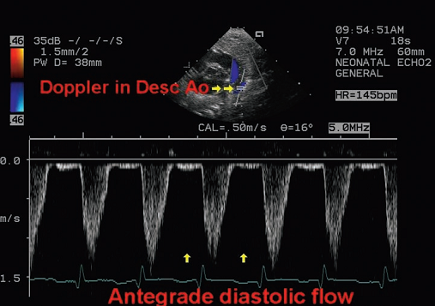
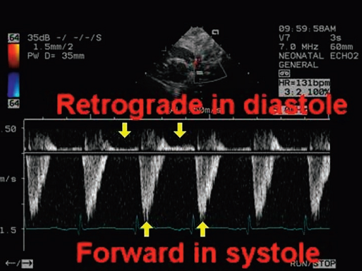
Diastolic flow reversal in Descending Ao
PWD in PDA
NORMAL FLOW
Retrograde diastolic flow –VTId/VTIs >30% ~ QP/Qs>1.6

Slide 6
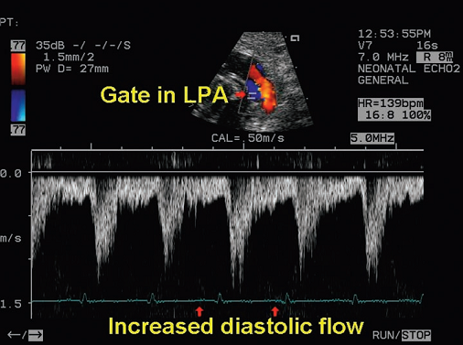
Increased diastolic flow in branch PAs

Slide 7
SHUNT CALCULATION

Slide 8
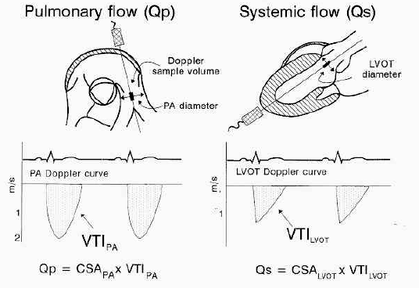

Slide 9
Pulmonary Vascular Resistance
PVR = mean PAP – mean LAP (or PCWP)
Qp
-in Woods Unit (mmHg/L/min)
SVR = mean systemic arterial P – mean RAP
Qs
PVRI= PVR/ BSA (Sq. m.)

Slide 10
When not to do
IF
PAP >2/3 MBP
or PAR>2/3 SAR
Closure can be recommended
If there is a net left-to-right shunt of at least 1.5:1
Evidence of pulmonary artery reactivity
>7 WU/m2 –
Vasodilator therapy and newer drugs affecting pulmonary arteriolar matrix composition and smooth muscle tone are likely to play an important role in the treatment of patients with pulmonary hypertension and ASD or

Slide 11
Acute vasodilator challenge using oxygen/ nitric oxide
Favorable outcome:
A decrease of 20% in the PVRI.
A decrease of around 20% in the ratio of pulmonary to systemic vascular resistance
A final PVR index of <6 Woods units/m2.
A final ratio of resistance of <0.3.

